Slide 1
Security Evaluation of Communication Protocols
ICCC 2012, Paris
Georges Bossert, Frédéric Guihéry
AMOSSYS, Supélec
Page 1

Slide 2
Evaluation of Communication Protocols
Authors
AMOSSYS
  ITSEF security lab
    CC and CSPN
  Based in Rennes (Brittany, France)
  www.amossys.fr
Supélec CIDer Research Team
  Joint research group team between Inria, University Rennes 1 and CNRS
  Focus on Intrusion Detection (but not only)
  Based in Rennes
  www.rennes.supelec.fr/ren/rd/cidre/
Page 2

Slide 3
- Context
- Evaluation of Communication Protocols
- Netzob project
- Modeling Protocols
- Inferring Protocol Model
- Simulating Inferred Protocol Model
- ATE class
- AVA class
- Conclusion
Evaluation of Communication Protocols

Slide 4
Context
Evaluation of Communication Protocols
Evaluation of Communication Protocols

Slide 5
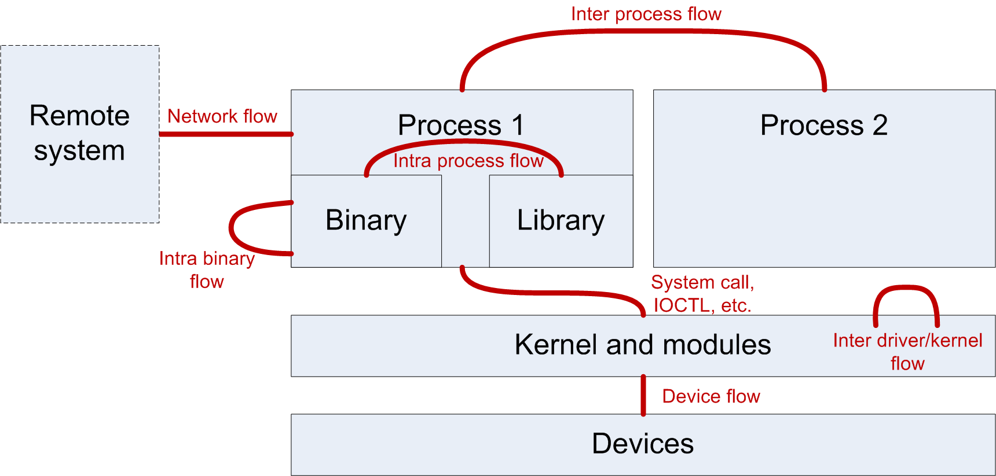
Evaluation of Communication Protocols
Context
Perimeter of our talk - security evaluation of
  Implementation of secure protocols
    IKE, IPsec, TLS, EAP, proprietary protocols, etc.
  Security products that detect, filter, block, transform a communication flow
    NIDS, HIDS, FW, AV
Page 5

Slide 6
Evaluation of Communication Protocols
Context
Identification of needs
  Implementation of secure protocols
    Protocol compliance of implementation regarding specification (RFC 2409 for IKE)
    Vulnerability analysis of protocol implementation
  Security products that analyze communication flow
    Capabilities of flow analyzers (FW, IDS, etc.) to filter/block/transform specific communications
Page 6

Slide 7
Evaluation of Communication Protocols
Context
Current state
  Security evaluations relies on well-known and recognized tools
  Tools for protocol compliance
    Sniffers and dissectors (Scapy, Wireshark, SSLsniff, etc.)
  Tools for detection capability
    Traffic generators and replay (Scapy, TCPreplay, etc.)
  Tools for vulnerability analysis
    Fuzzers (Peach, Sulley, zzuf, PROTOS, etc.)
    Fingerprint analysis (nmap, sinFP, p0f, etc.)
Page 7

Slide 8
Evaluation of Communication Protocols
Context
Current limitations
  Most test tools only manipulates known protocols
  Protocol-agnostic tools give poor results (fuzzers)
    Efficiency of vulnerability analysis is strongly tied to previous protocol knowledge
  Proprietary protocol compliance analysis relies on manually made test cases
    Adding new protocols is time/resources consuming
Page 8

Slide 9
Evaluation of Communication Protocols
Context
Consequences
  Impossibility to efficiently analyse/generate proprietary protocols with limited resources
  Examples
    Botnet detection capability for NIDS
    Malicious IPC flow for AV and HIDS, etc.
    Fuzzing of proprietary protocols with poor/incomplete/obsolete documentation
Lead to the creation of Netzob
Page 9

Slide 10
Netzob Project
Evaluation of Communication Protocols

Slide 11
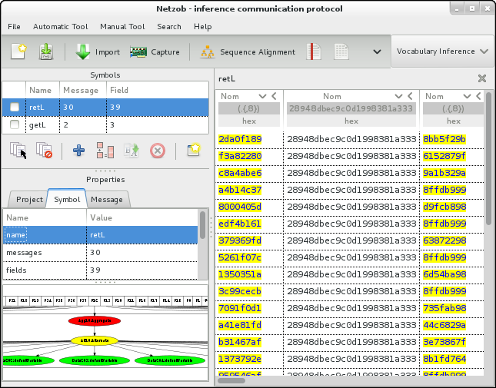
Evaluation of Communication Protocols
Netzob Project
  Goals of Netzob
    Infer proprietary protocols
    Simulate actors of a communication
    Smart-Fuzz targeted implementations
  Open source project initiated by
    AMOSSYS ITSEF
    Supelec CIDre research team
  Leverages
    Bio-informatic algorithms
    Automata theory
Page 11

Slide 12
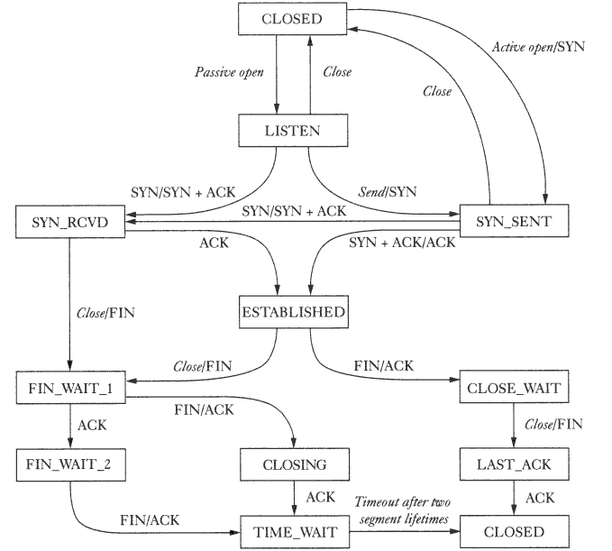
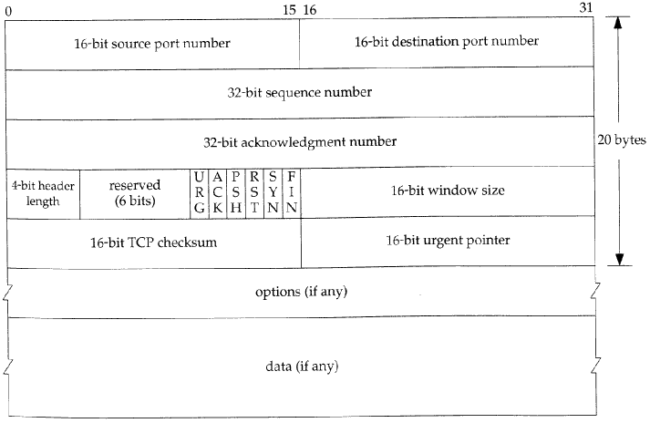
Evaluation of Communication Protocols
Netzob Project
A protocol is made of
  A list of messages and their formats (Vocabulary)
  A set of procedural rules to ensure consistency in exchanged messages (Grammar)
Two ways to learn a protocol based on exchanged messages
  manual analysis
  passive or active inference
Page 12

Slide 13
Netzob Project
Modeling Protocols
Evaluation of Communication Protocols

Slide 14
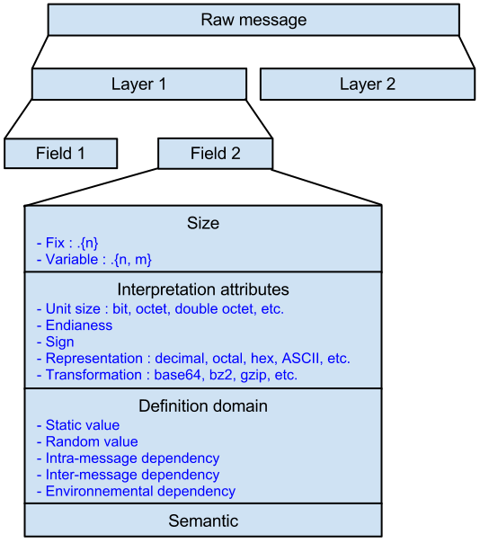
Evaluation of Communication Protocols
Netzob Project
  Model of message format
Page 14

Slide 15
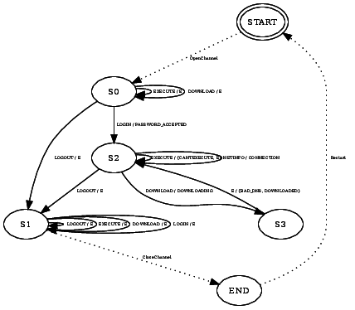
Evaluation of Communication Protocols
Netzob Project
  Model of the grammar
  Model relations between an input symbol and an output symbol following the current state.
    Automaton (IO Mealy)
  Allows multiple output symbols given a specific couple <current state, input symbol>
    Stochastic Mealy Machine
    Ex: Answer “yes” (80%) or “no” (20%)
  Add the reaction time on each transition
    SMMDT
Page 15

Slide 16
Netzob Project
Inferring Protocol Model
Evaluation of Communication Protocols

Slide 17
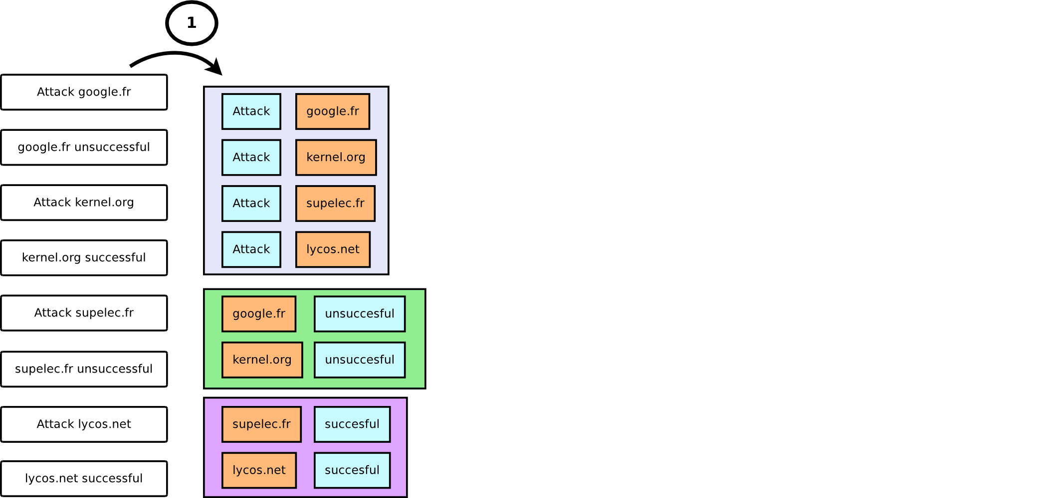
Evaluation of Communication Protocols
Netzob Project
#1 : Splitting and clustering
  Split in fields
  Regroup similar messages
  Semi-automatic approach
Page 17

Slide 18
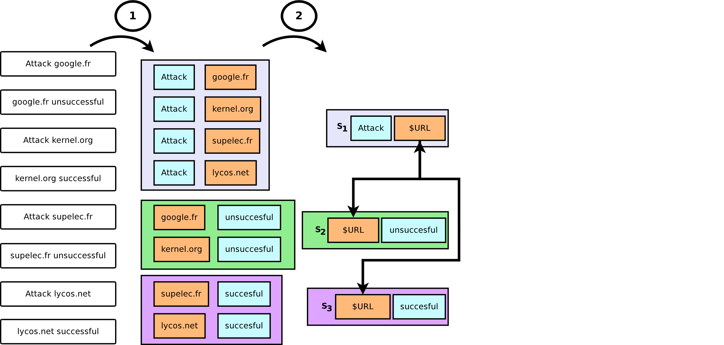
Evaluation of Communication Protocols
Netzob Project
#2 : Abstract in symbols
  1 cluster = 1 symbol
  Abstract fields
  Identify dependencies
Page 18

Slide 19
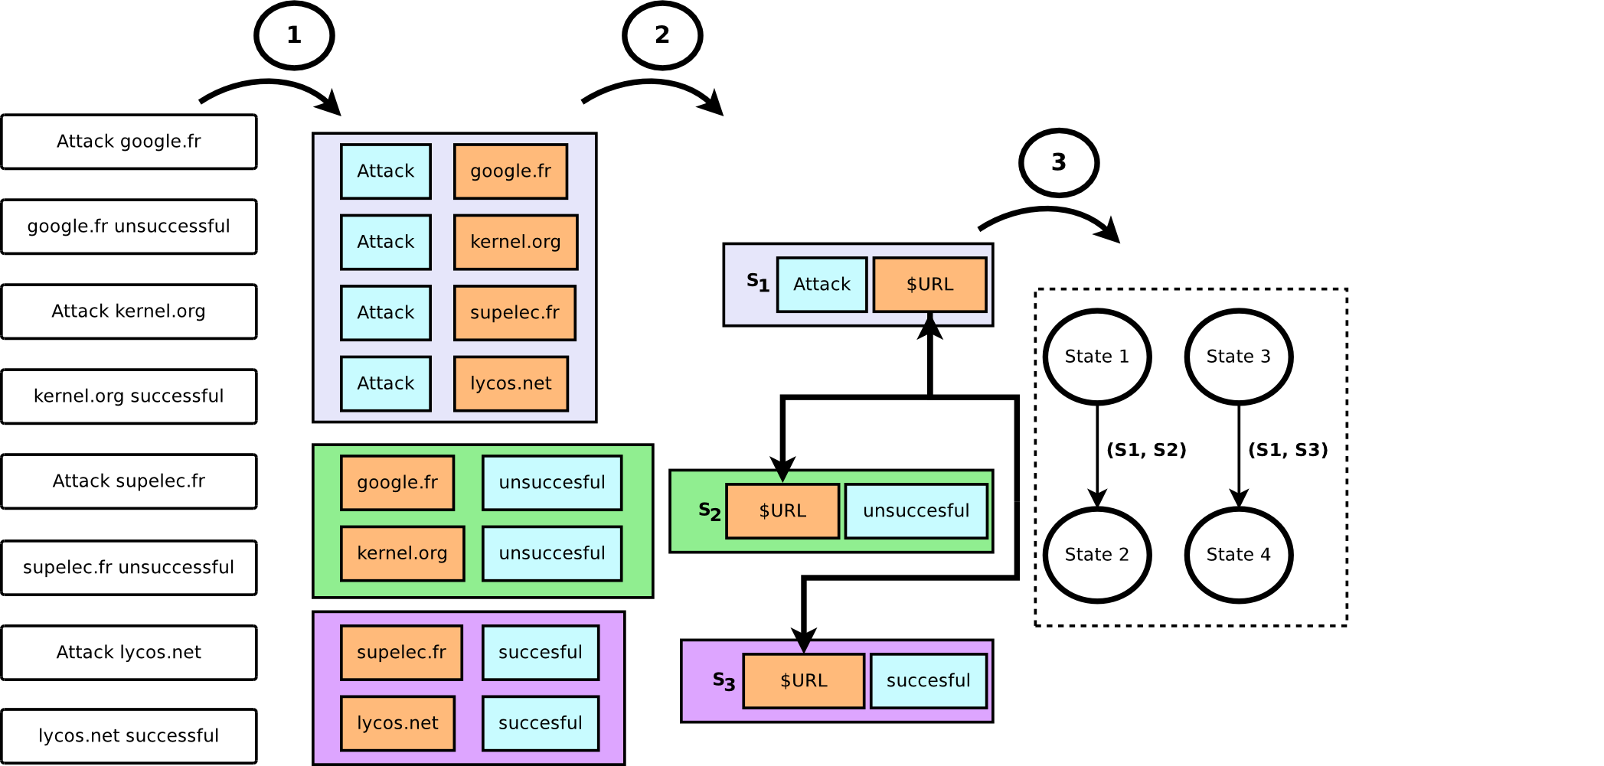
Evaluation of Communication Protocols
Netzob Project
#3 : Inferring transition graph
  Active inference (determinist graph) : Angluin's L*
Page 19

Slide 20
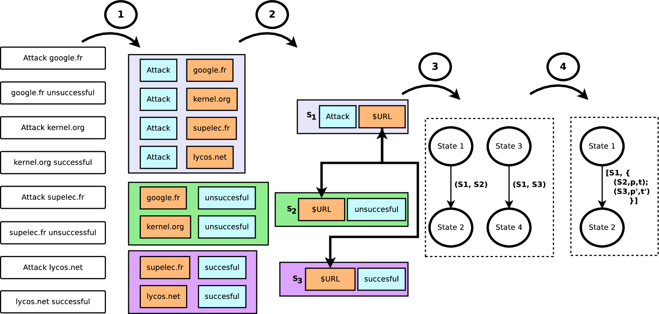
Evaluation of Communication Protocols
Netzob Project
#4 : Generalization of the automaton
  Output indeterminism
  Reaction time inference
Page 20

Slide 21
Evaluation of Communication Protocols
Netzob Project
Tune and adapt the inferring process with dedicated tools
  Manual sequencing
  Fields type identification
    Primary types (binary, ascii, num, base64, ...)
    Computes the definition domain of a field (unique elements)
  Semantic data identification
    Emails, IP, ...
    Environmental dependencies
  Fields relations identification
    Length fields and associated payloads
    Encapsulated messages identifications
  Fields statistical distribution
Page 21

Slide 22
Netzob Project
Simulating Inferred Protocol Model
Evaluation of Communication Protocols

Slide 23
Evaluation of Communication Protocols
Netzob Project
Simulating protocols
  Follows inferred message format and protocol automaton
  Creates actors
    Client (http navigator)
    Server (http server)
  Configures the model usage
    Initiates communication (or wait for)
  Specific execution context (IP, logins, MAC, …)
  Injects values in symbols
    Contextualized emitted messages
    Learn values from received messages
  Abstraction from the communication channel
    Ex: Send USB messages through TCP
Page 23

Slide 24
ATE class
Evaluation of Communication Protocols

Slide 25
Evaluation of Communication Protocols
ATE class
  ATE test class
    “Provides assurance the TOE behaves as documented in the Functional Specification (ADV_FSP)”
  Application examples
    Secure protocol implementations (such as IPsec, TLS/SSL, EAP, etc.)
      Protocol Compliance : Compare an implementation to its specification
    Flow analyzers (such as IDS/IPS, firewall, ACL, etc.)
      Detection Capabilities : Generate realistic and controllable test flows
Page 25

Slide 26
Evaluation of Communication Protocols
ATE class
  Protocol Compliance : Compare an implementation to its specification
STEP 1
Observe an implementation
STEP 2
Infer its model
(message format and protocol automaton)
STEP 3
Compare models
(search for deviations)
Page 26

Slide 27
Evaluation of Communication Protocols
ATE class
  Detection Capabilities : Generate realistic and controllable test flows:
STEP 1
Capture proprietary/malicious traffic
STEP 2
Infer its model
(message format and protocol automaton)
STEP 3
Simulate realistic actors
(generate reproducible and contextualized traffic)
STEP 4
Analyze TOE behavior
(ATE_FUN, ATE_COV, ATE_IND)
Notes:
STEP 3 : Its traffic simulator engines is then able to generate realistic and reproducible traffic in order to assess the compliance of security functions and their coverage in terms of supported protocols and detected attacks.
In the case of an IDS, Netzob could be use to generate realistic traffic of a botnet Command & Control channel.

Slide 28
Evaluation of Communication Protocols
ATE class
  Usable by developers and evaluators
    for developers : functional tests (ATE_FUN) and coverage (ATE_COV) families
    for evaluators : independent testing family (ATE_IND)
  As an Open-Source project, Netzob can be part of the same tool-list for each side

Slide 29
AVA class
Evaluation of Communication Protocols

Slide 30
Evaluation of Communication Protocols
AVA class
AVA_VAN class
  “Tries to determine the existence and exploitability of flaws or weaknesses in the TOE in the operational environment”
Vulnerability analysis approaches
  Public vulnerability analysis
  Static analysis (code source, bytecode or binary)
  Dynamic analysis
    Debugging
    Tracing
    Robustness testing / fuzzing
Page 30

Slide 31
Evaluation of Communication Protocols
AVA class
Problem statement (basic fuzzers are bad, we need smart fuzzers)
  To be fully efficient, fuzzing must cover the complete definition domain and combinations of fields and message format.
    Implies an exponential combination of tests
  Fuzzing should also cover the protocol state machine
    Brings another huge set of variations.
  Basic fuzzers are very time consuming with no result assurance limiting its efficiency.
  Fuzzing is only relevant when tool has previous knowledge of targeted protocol (smart fuzzers)
Page 31

Slide 32
Evaluation of Communication Protocols
AVA class
  However in the context of proprietary protocols, smart fuzzers are not available → Netzob can create them
STEP 1
Observe an
implementation
STEP 2
Infer its model
(message format and protocol automaton)
STEP 2bis
Manually refine model
(ADV_TDS, ADV_IMP)
STEP 3
Simulate smart fuzzing actors
(support fuzzing mutation and generation)
STEP 4
Analyze TOE behavior
(AVA_VAN)
Page 32

Slide 33
Conclusion
Evaluation of Communication Protocols

Slide 34
Evaluation of Communication Protocols
Conclusion
Open source tool to infer, simulate and fuzz protocols
  Maintained by a community of experts
Netzob helps developers and CC evaluators where automation, accuracy and reproducibility are essential
  Attesting protocol compliance
  Testing detection capabilities
  Realizing vulnerability analysis of implementations
Successfully applied in AMOSSYS ITSEF and in research team (Supelec CIDer)
Provide up-to-date academic researches in an operational context
Page 34

Slide 35

Evaluation of Communication Protocols
Conclusion
Questions ?
www.netzob.org
@Netzob

